Slide 1

Analyzing Golang Malware: Detection, Deobfuscation, and C2 Framework Development
Lochlan Scharpf, Katie Trinh, Sarah Temple

Slide 2
Table of Contents
01
02
03
04
05
06
Introduction and Motivation.
Related Work.
Methodology.
Evaluation.
Ways to Improve.
Live Demo.

Slide 3
01
Introduction and Motivation

Slide 4
Introduction
Golang & Malware Development: Malware is designed to harm computer systems, and Go has gained popularity due to its networking capabilities. Unlike traditional languages like C, Go's design offers unique advantages for adversaries.
Challenges in Detection & Analysis: Security tools have well-established methods for detecting C-based malware, but Go's binary structure, runtime behavior, and error handling introduce new challenges for antivirus software and reverse engineering.
MOTIVATION
Growing Cyber Threat & Impact: Go-based malware has increased by 2,000% since 2017 (Intezer, 2025), making it a significant emerging threat. Our research seeks to improve defenses by identifying weaknesses in current detection techniques.
Research Goals & Methodology: We aim to develop a Golang-based C2 framework to evaluate detection, obfuscation, and mitigation. Our analysis includes testing implants against antivirus tools (e.g., VirusTotal) and using Ghidra for reverse engineering comparisons.

Slide 5
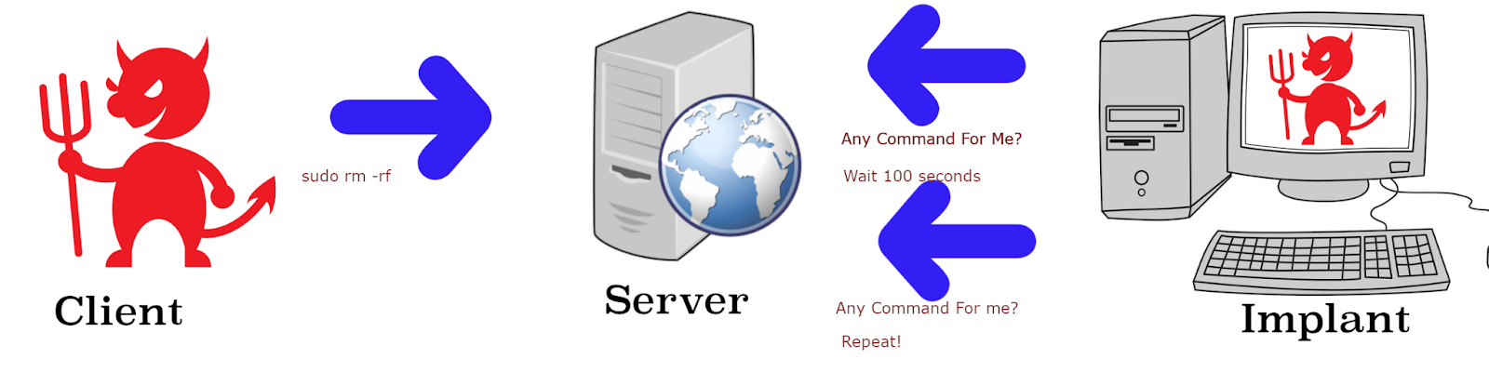
Client

Slide 6
02
Related Work

Slide 7
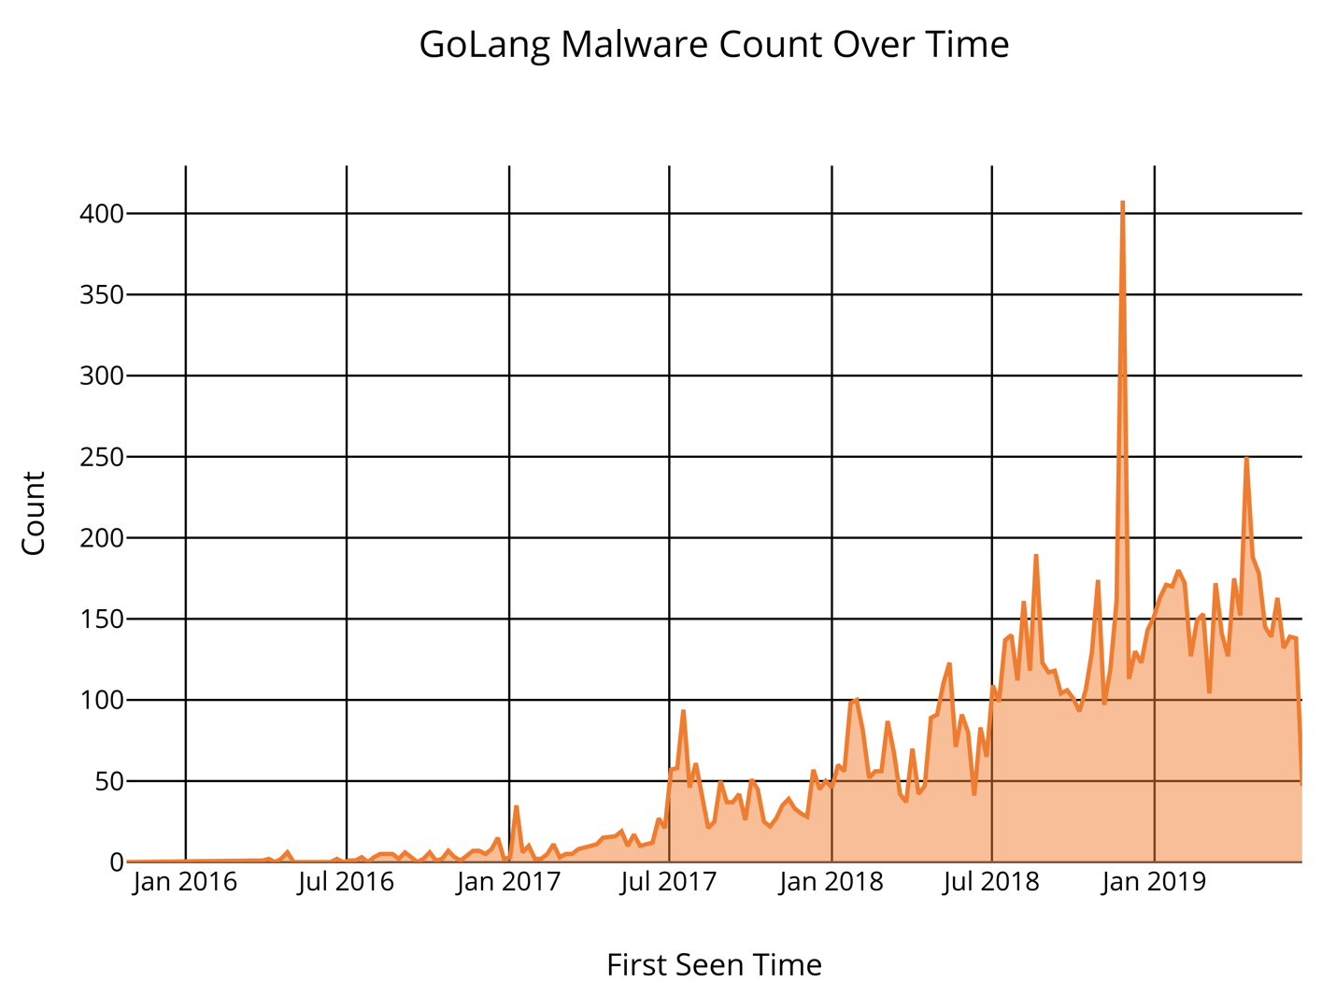
Related Work
The Rise of Golang:
CrowdStrike observed an 80% increase in Go-written malware from June to August 2021 (Maurya)
Intezer states "Before 2019, spotting malware written in Go was more a rare occurrence and during 2019 it became a daily occurrence,"(Xochihua)
Challenges in Golang Malware Detection:
Go's cross-compilation allows malware to target multiple platforms, while static binaries and obfuscation techniques make analysis more difficult. Traditional signature-based detection methods struggle with Go's unpredictable binary structure, requiring more advanced detection approaches. (MDPI)
Source: Grunzweig, Josh. Palo Alto Networks. “The Gopher in the Room: Analysis of GoLang Malware in the Wild.”
Notes:
Sliver C2 (golang) is a big competitor in the C2 market, open source makes it more popular than cracked cobalt strike copies.

Slide 8
03
Methodology

Slide 9
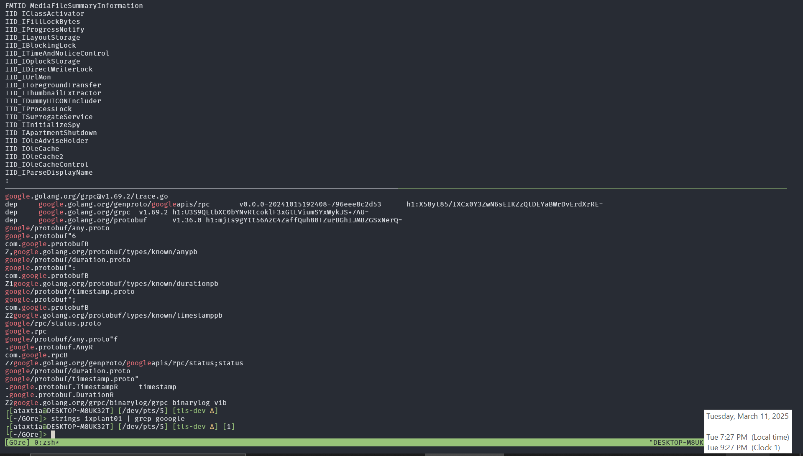
Methodology: How did we develop the Golang-based C2 framework, test its detection, and compare it to C-based malware?
The Framework:
Atypical C2 Framework with server, admin client, and victim implant
HTTP2 Google Remote Procedure Calls (gRPC) for protocol between services
The Testing:
Wireshark PCAP from victim machine to C2 server
framework on localhost, then migrated server to ix-dev for DNS testing
The Comparisons:
GOre:
  Single, static binary, larger size, harder to reverse.
  garble wrapper makes mandiant GoReSym unable to get unhashed library names.
C-Based example:
  dynamically linked, smaller size, easier to reverse
  strings show useful information, like libraries and debug info
Notes:
2 minutes, picture is a strings search on a basic C keylogger I found, then on the unobfuscated binary, and finally on the obfuscated binary.

Slide 10
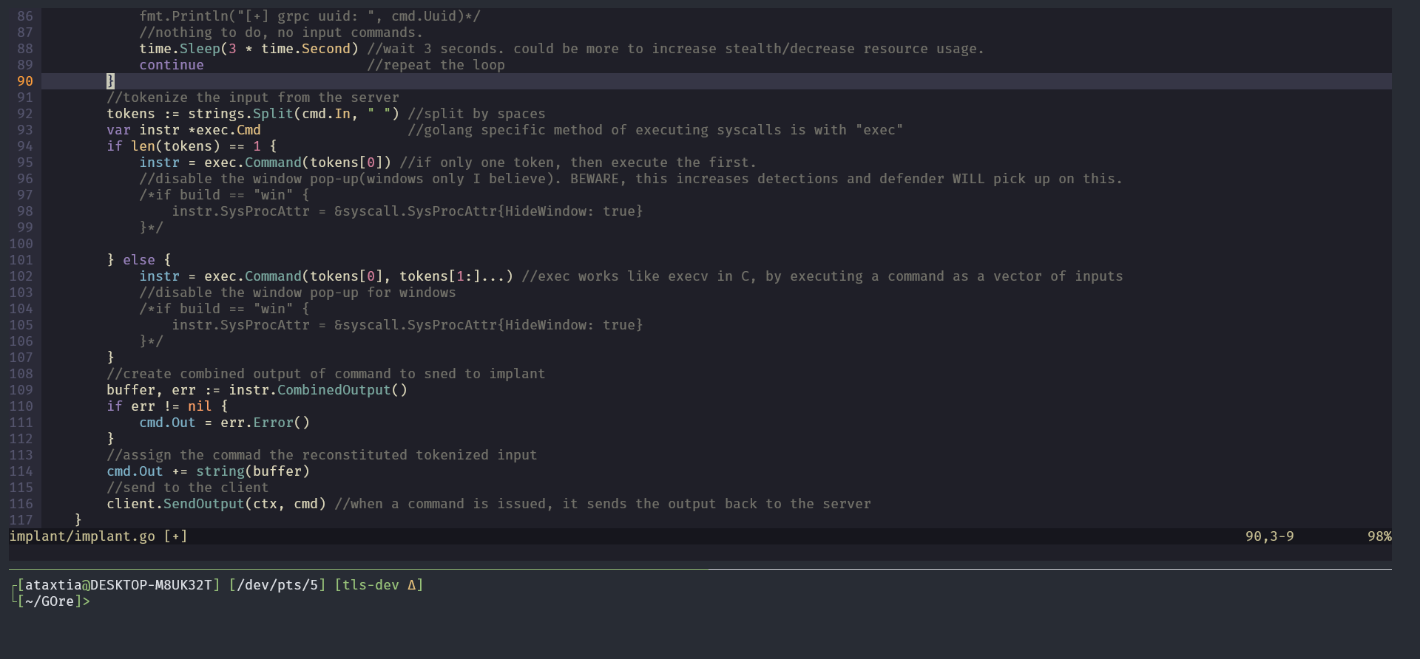
Notes:
2 minutes

Slide 11
04
Evaluation

Slide 12
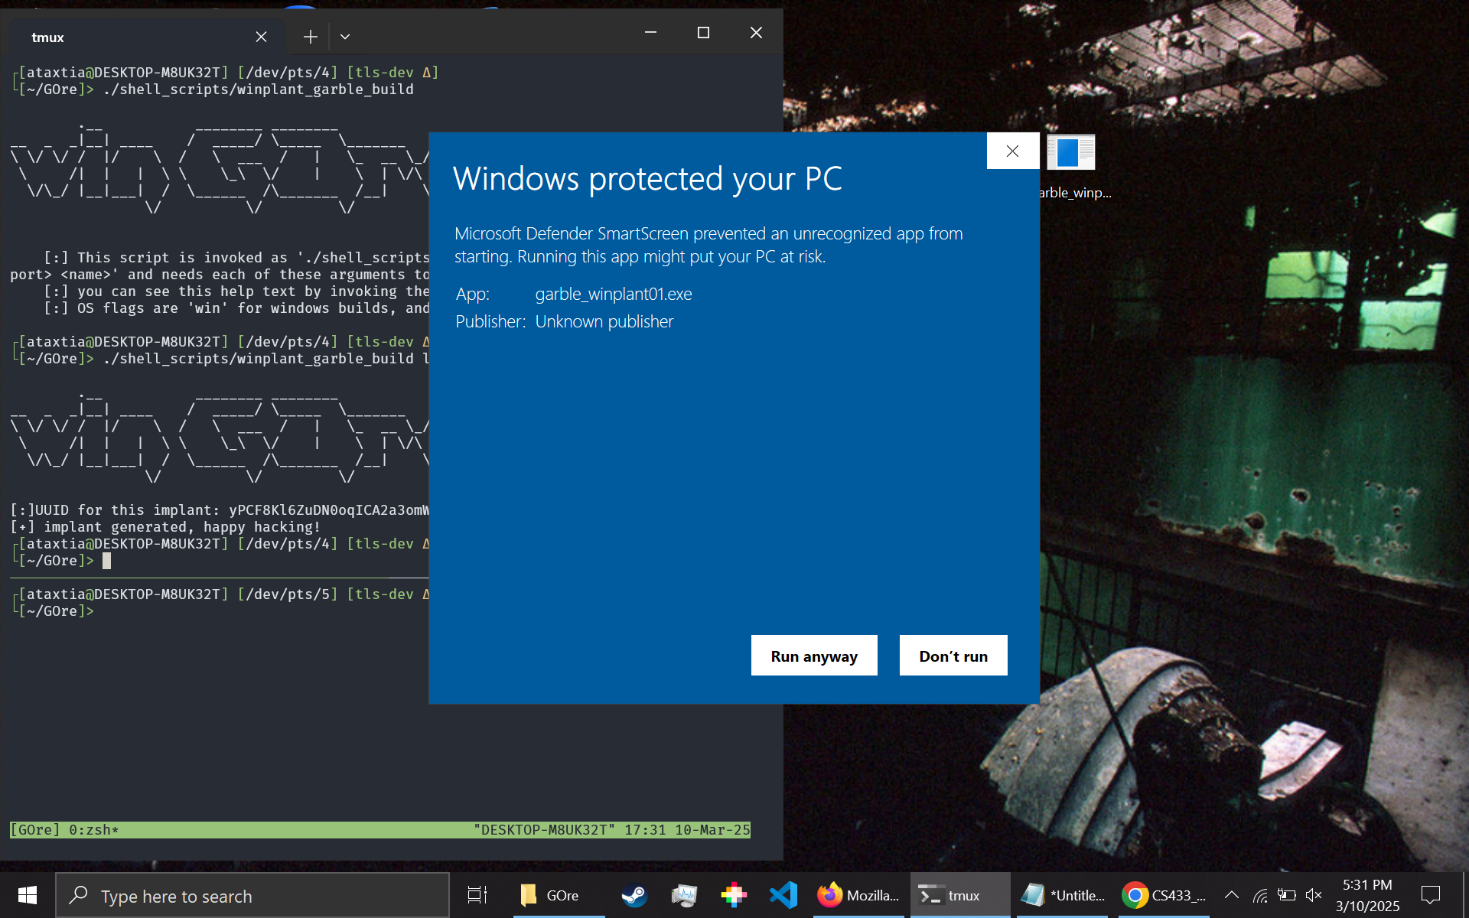
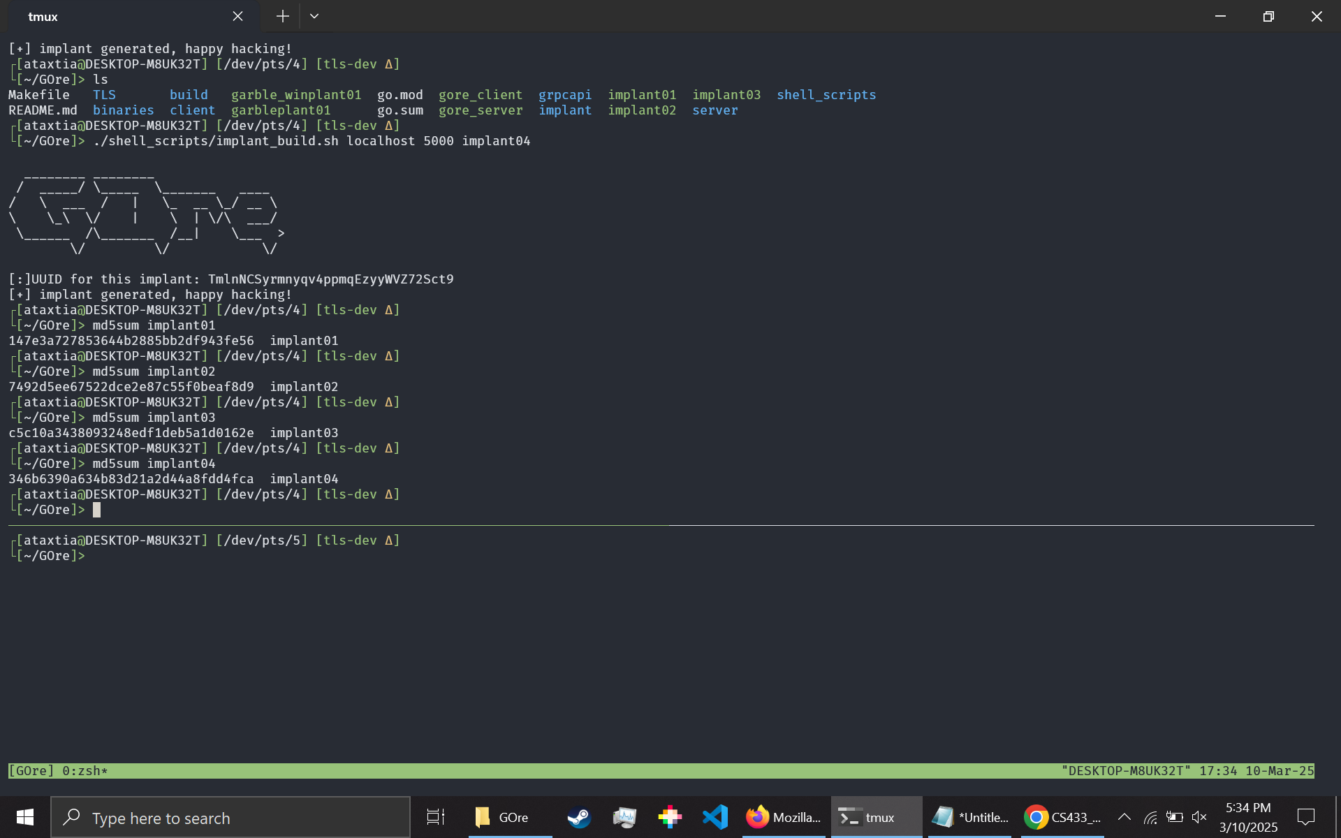
Evaluation
Detection Results
unobfuscated will not run in windows, obfuscated will, with a warning.
Golang creates larger compiled file sizes which typical malware scanners have difficulty parsing.
The signature changes every time its compiled.
Screenshots?
Notes:
1 minute? 2? I think it’d be better to save more time for the demo depending on how long that goes

Slide 13
05
Ways To Improve

Slide 14
Ways To Improve
Future Research Ideas
Future Development of Malware
How other languages change deobfuscation results?
How could a virus scanning software account for the larger file size?
Adding a terminal set up to interact with each implant without sending one command at a time.
Other ways to hide from windows defender.

Slide 15
06
Live Demo!
Plus CTF!
https://ctf.uosec.org/

Slide 16
References
Anmol Maurya, “Financial Motivation Drives Golang Malware Adoption | CrowdStrike,” Crowdstrike.com, 2025. https://www.crowdstrike.com/en-us/blog/financial-motivation-drives-golang-malware-adoption/ (accessed Mar. 16, 2025).
M. Azeem, D. Khan, S. Iftikhar, Shaikhan Bawazeer, and M. Alzahrani, “Analyzing and comparing the effectiveness of malware detection: A study of machine learning approaches,” Heliyon, vol. 10, no. 1, pp. e23574–e23574, Jan. 2024, doi: https://doi.org/10.1016/j.heliyon.2023.e23574.
‌burrowers, “GitHub - burrowers/garble: Obfuscate Go builds,” GitHub, Feb. 12, 2025. https://github.com/burrowers/garble (accessed Mar. 15, 2025).
Catalin Cimpanu, “Go malware is now common, having been adopted by both APTs and e-crime groups,” ZDNET, Feb. 26, 2021. https://www.zdnet.com/article/go-malware-is-now-common-having-been-adopted-by-both-apts-and-e-crime-groups/ (accessed Mar. 15, 2025).
“Dealing with False Positives of Golang Apps on Windows,” Steve Zazeski, May 14, 2023. https://steve.zazeski.com/false-positives-of-golang-on-windows/ (accessed Mar. 15, 2025).
J. Grunzweig, “The Gopher in the Room: Analysis of GoLang Malware in the Wild,” Unit 42, Jul. 01, 2019. https://unit42.paloaltonetworks.com/the-gopher-in-the-room-analysis-of-golang-malware-in-the-wild/
R. Pike, “Go at Google: Language Design in the Service of Software Engineering - the Go Programming Language,” go.dev, 2012. https://go.dev/talks/2012/splash.article
microsoft, “Microsoft defender false positives of Go binaries on windows · Issue #1255 · microsoft/go,” GitHub, 2024. https://github.com/microsoft/go/issues/1255 (accessed Mar. 15, 2025).
‌Public, “Public domain stock image. Arrow blue play, computer communication. - PICRYL - Public Domain Media Search Engine Public Domain Search,” PICRYL - Public Domain Media Search Engine, 2017. https://picryl.com/media/arrow-blue-play-computer-communication-3665a7 (accessed Mar. 15, 2025).
SereneHaze, “GitHub - SereneHaze/GOre: a repo for version control of the GOre C2 framework,” GitHub, 2024. https://github.com/SereneHaze/GOre (accessed Mar. 16, 2025).
‌soufianetahiri, “Mirai-Botnet/mirai/bot/main.c at master · soufianetahiri/Mirai-Botnet,” GitHub, 2016. https://github.com/soufianetahiri/Mirai-Botnet/blob/master/mirai/bot/main.c (accessed Mar. 15, 2025).
‌“VirusTotal,” www.virustotal.com. https://www.virustotal.com/gui/

